Slide 1
A Spatio-Temporal Appearance Representation for Video-based Pedestrian Re-Identification
Kan Liu, Bingpeng Ma, Wei Zhang, Rui Huang
ICCV 2015
Submission ID: 1276
Notes:
This paper is about a spatio-temporal appearance representation for video-based pedestrian re-identification.

Slide 2
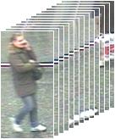
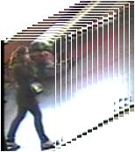

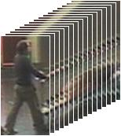
Pedestrian re-identification tasks
Notes:
Given a video sequence of a person, the goal of the pedestrian re-identification is to match a query against the gallery set.

Slide 3
Pedestrian re-identification datasets
Poses and Viewpoints
Occlusions
Illumination
Notes:
Pedestrian re-id is a difficult problem due to the large variations in a person’s appearance caused by different poses and viewpoints, illumination changes, and occlusions. The spatial and temporal alignment plays an important role in this case.

Slide 4
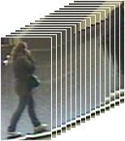
Spatio-temporal Representation
…
…
Notes:
We takes the video of a walking person as input and builds a spatio-temporal appearance representation for pedestrian re-identification.

Slide 5


Slide 6
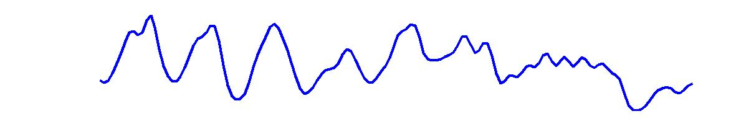


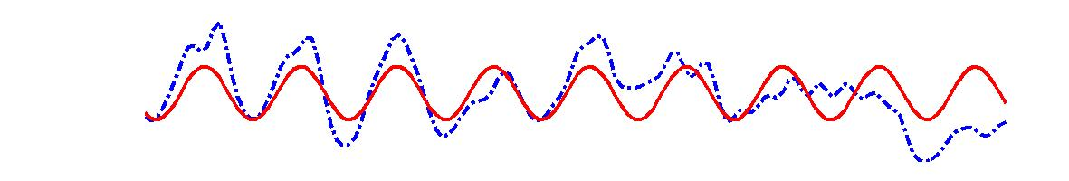

Walking cycles extraction
Notes:
Given a video sequence of a walking person, we first extract the individual walking cycles.

Slide 7
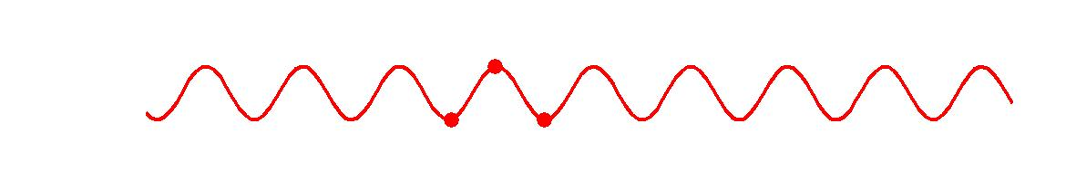
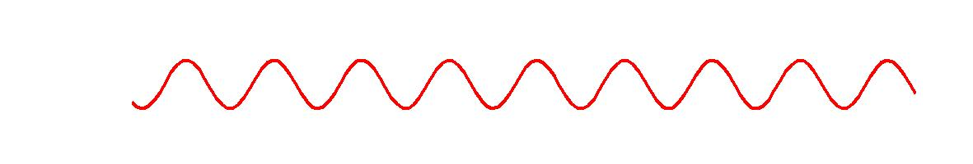
Walking cycles extraction
Notes:
For each walking cycle, we divide the chunk of video data both spatially and temporally.

Slide 8
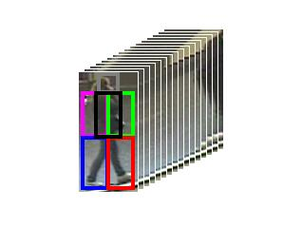
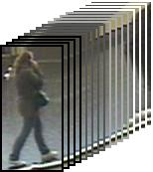
Temporal Segmentation
Spatial Segmentation
Body-action Unit
Notes:
We obtain multiple video blobs based on the spatial and temporal segmentation, and each video blob is a small chunk of data corresponding to a certain action primitive of a certain body part. We call it body-action unit.

Slide 9
Fisher Vectors
…
…
Concatenate
…
…
Notes:
Based on the spatio-temporally meaningful body-action units, we train visual vocabularies and extract Fisher vectors.
We then concatenate the Fisher vectors extracted from all the body-action units to form a fixed-length feature vector to represent the appearance of a walking person.

Slide 10
Pedestrian re-identification tasks
…
…
…
…
…
…
Notes:
Finally we compare the appearance representations extracted from each video and match the query sequence to the right one.

